Slide 1
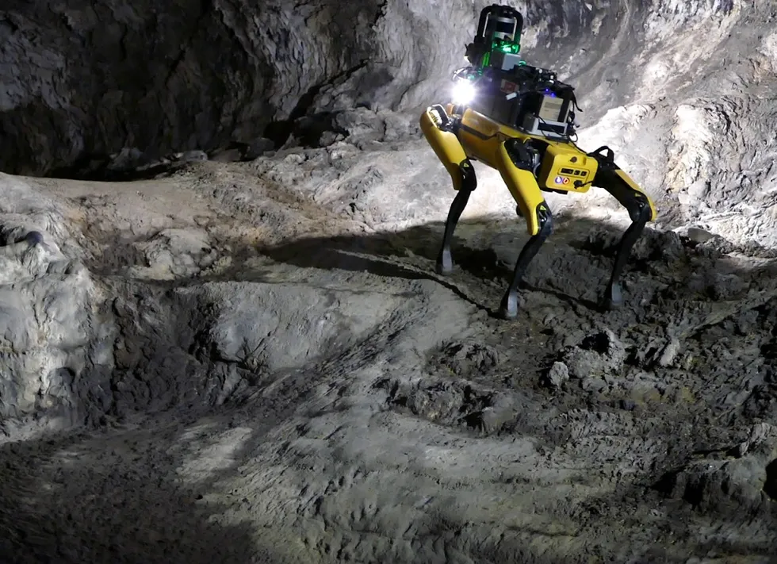
Cave examination bot (CEB)
A BoT PROGRAM DEVELOPED BY GROUP 9
H. Noorani (n01485518)
A. Mohebi (n01477361)
A. Dowuona (n01490404)
A. Calcines (n01489363)

Slide 2
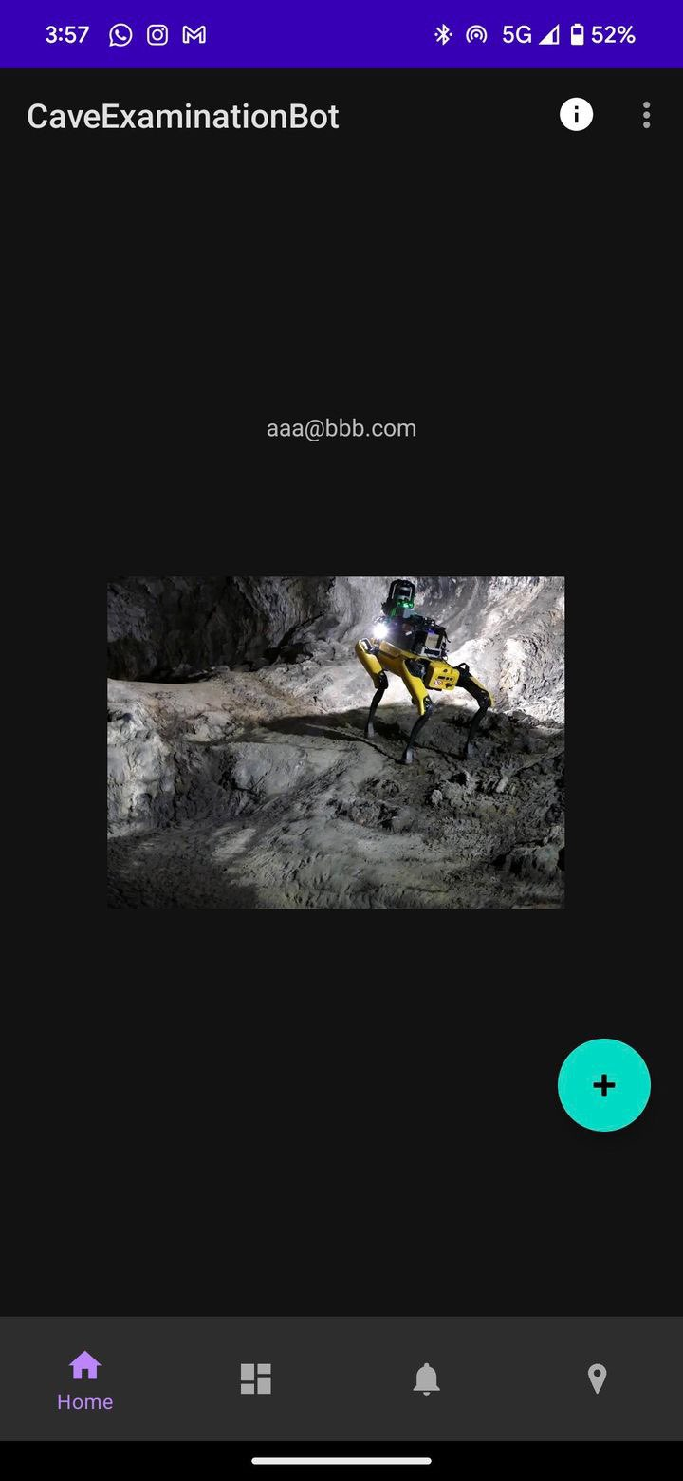
App Features
Realtime data reading
Mobile Bot Control
Live Alert Feed
Location Mapping relative to user

Slide 3
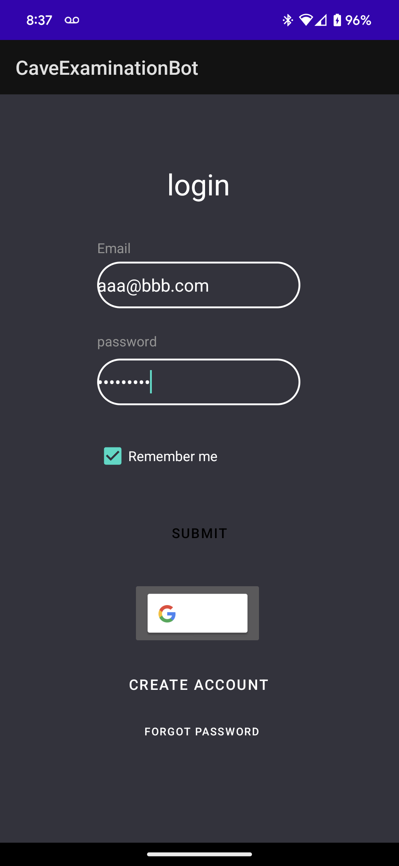
App screens – login screen
Login
We have implemented a user specific model by allowing the user to register and login within the app itself. The user can also use Google if they wish.

Slide 4
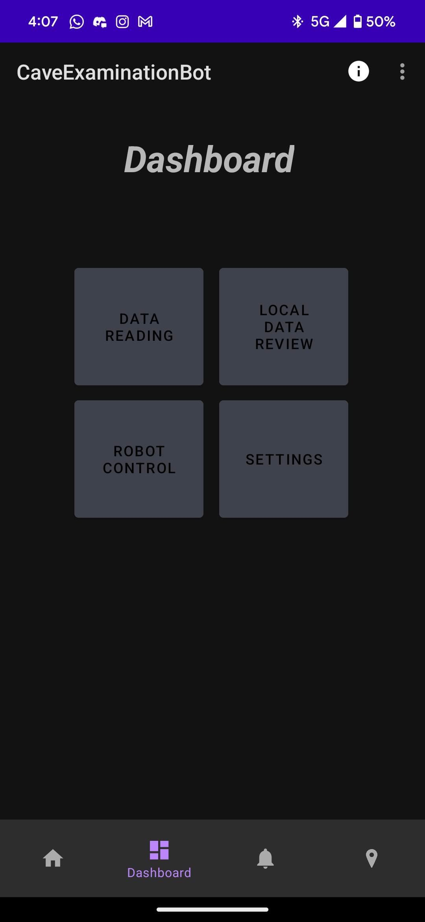
App screens - Dashboard
Dashboard
Here you will find that we have included a simple and clean UI design to give the user access to the dashboard and the various controls and features of the CEB

Slide 5
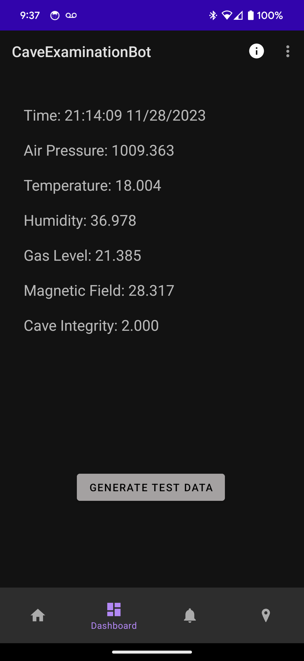
App screens – Realtime Database
Realtime Data Reading
We have implemented a data system that gives accurate readings of the CEB’s surroundings in real-time for the user to evaluate.

Slide 6
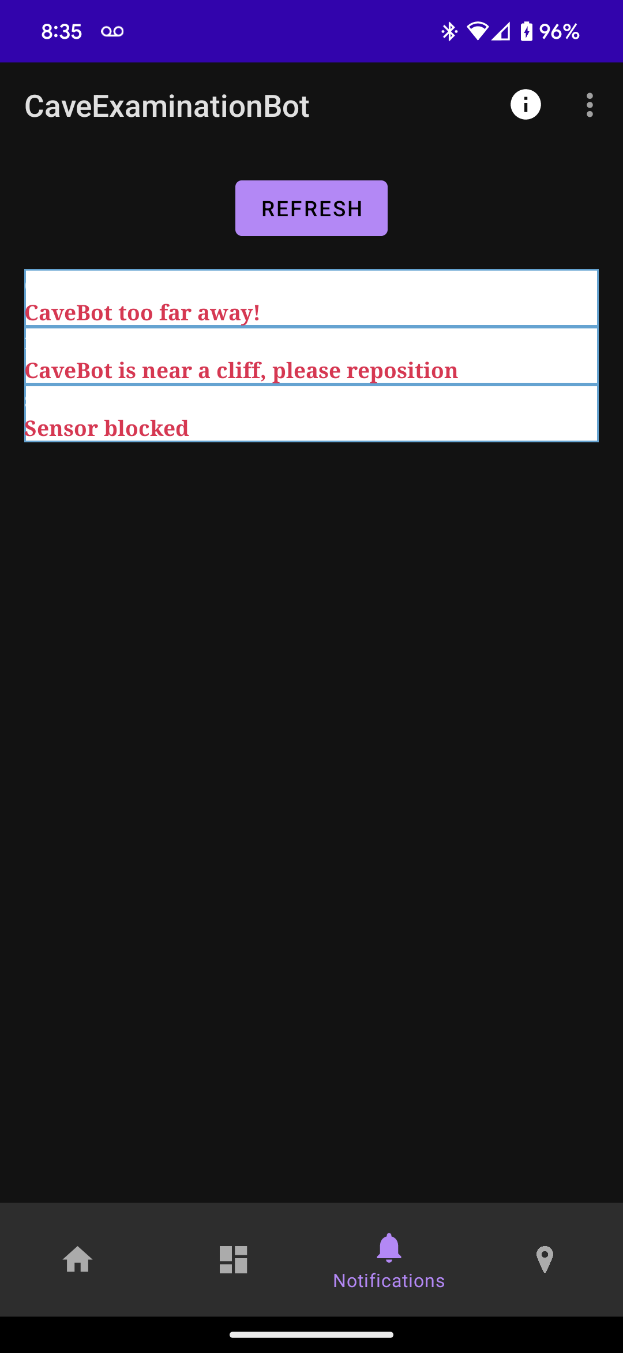
App screens - Alerts
Live Alerts
As the CEB explores, it is bound to hit a couple of unpredictable obstacles and we have implemented an alert system so that the user is well informed and always ready for any situation.
This page for our app is dedicated to display alerts and critical messages. This encourages users to be able to check events at a moment's notice.

Slide 7
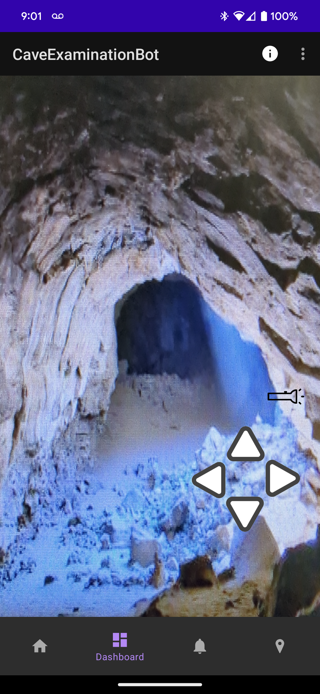
App screens – Camera Feed
Camera:
To elevate the experience even further and take full control of the CEB, we have added a competitive camera feature. This feature’s purpose is to get live feed from the CEB and control it in real time. It includes movement functions as well.

Slide 8
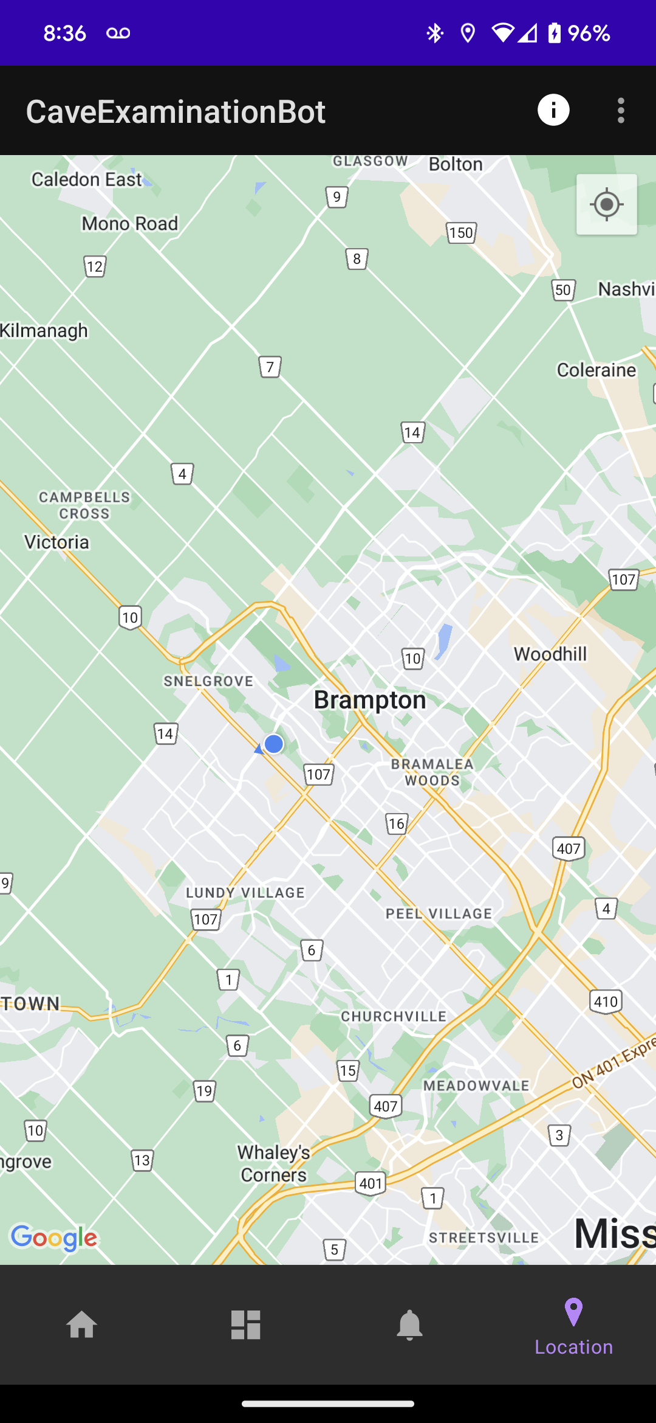
App screens – Maps and relative location
Location Details
One of our leading features is location tracking. This feature allows the user to track the CEB to its exact location to make sure it is where it is supposed to be and makes it an ease to map the cave.

Slide 9
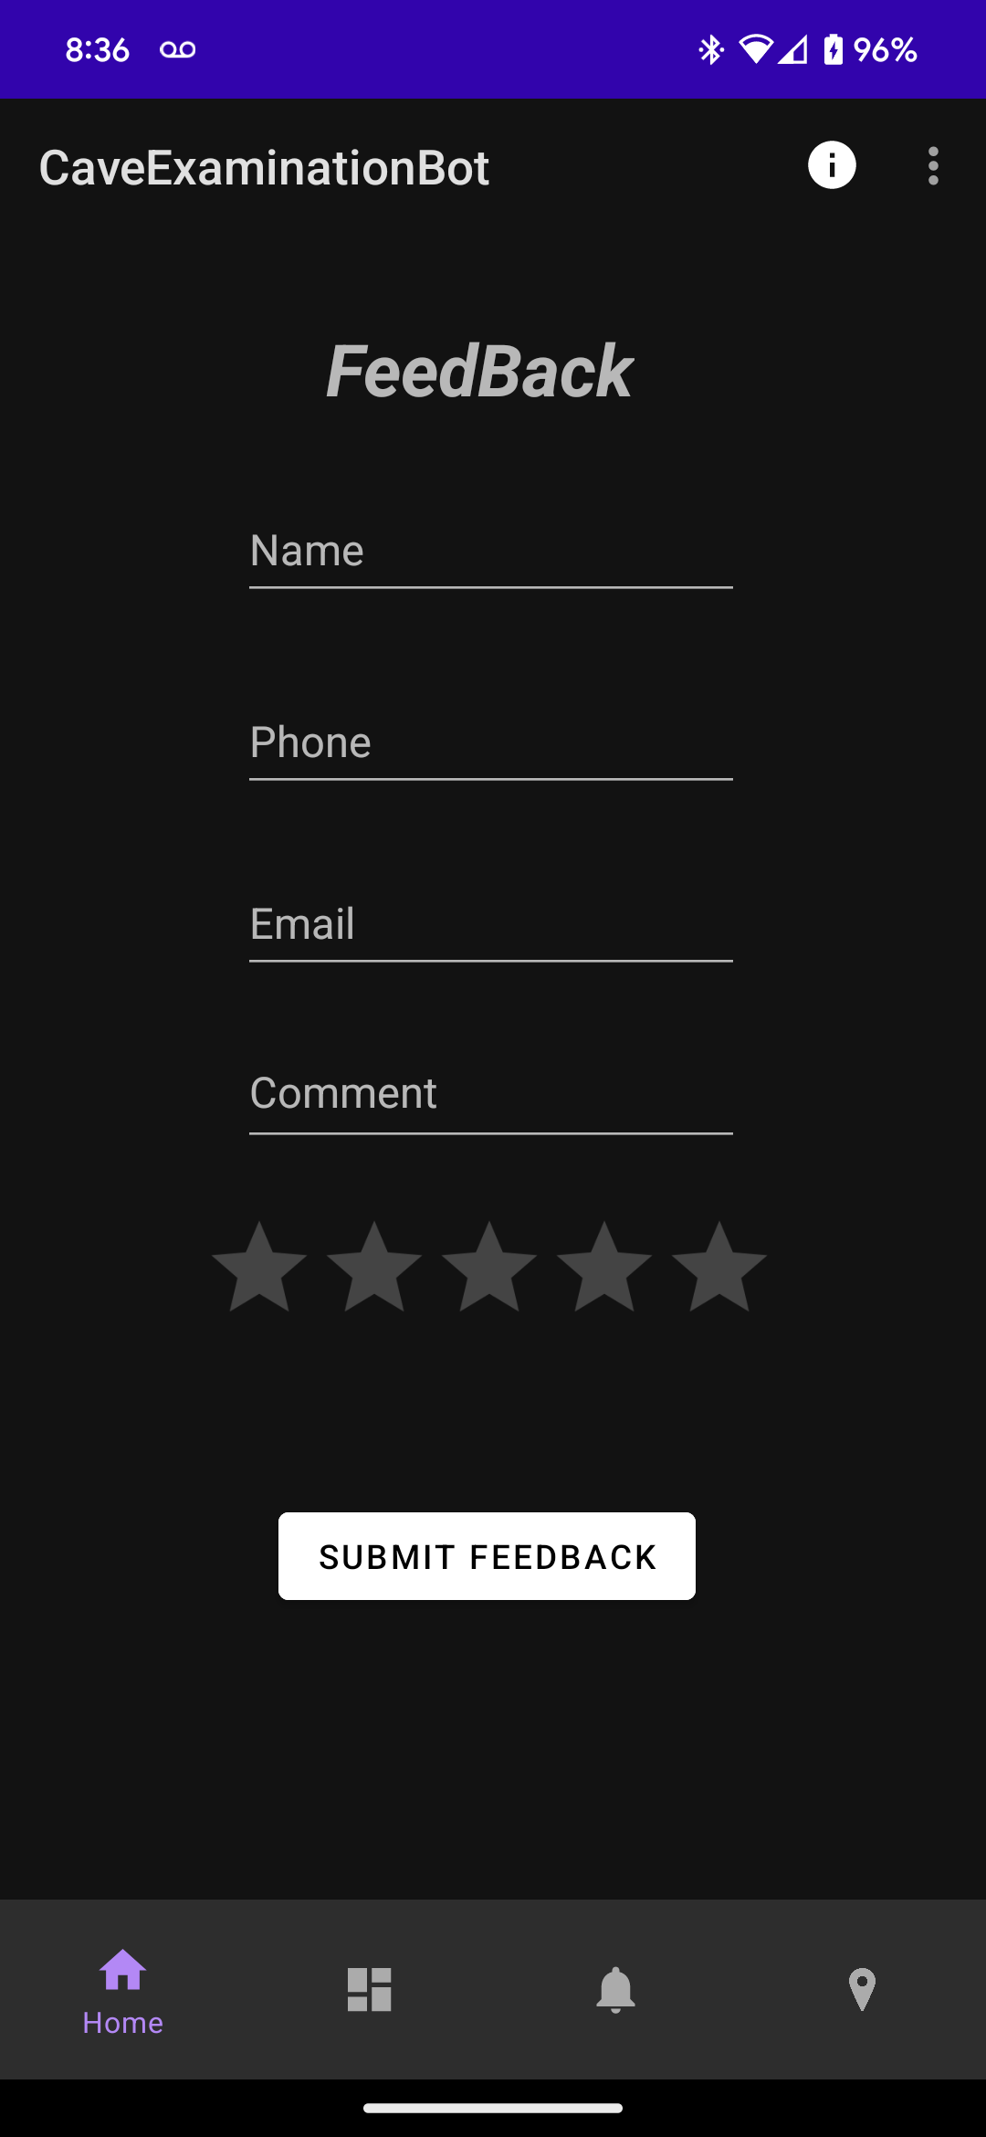
App screens – feedback
Feedback
As an up-and-coming mega start-up, we care about feedback from our users the most. We dynamically and proactively introduce functions and features that align with our customer’s needs and try to provide to the fullest.

Slide 10
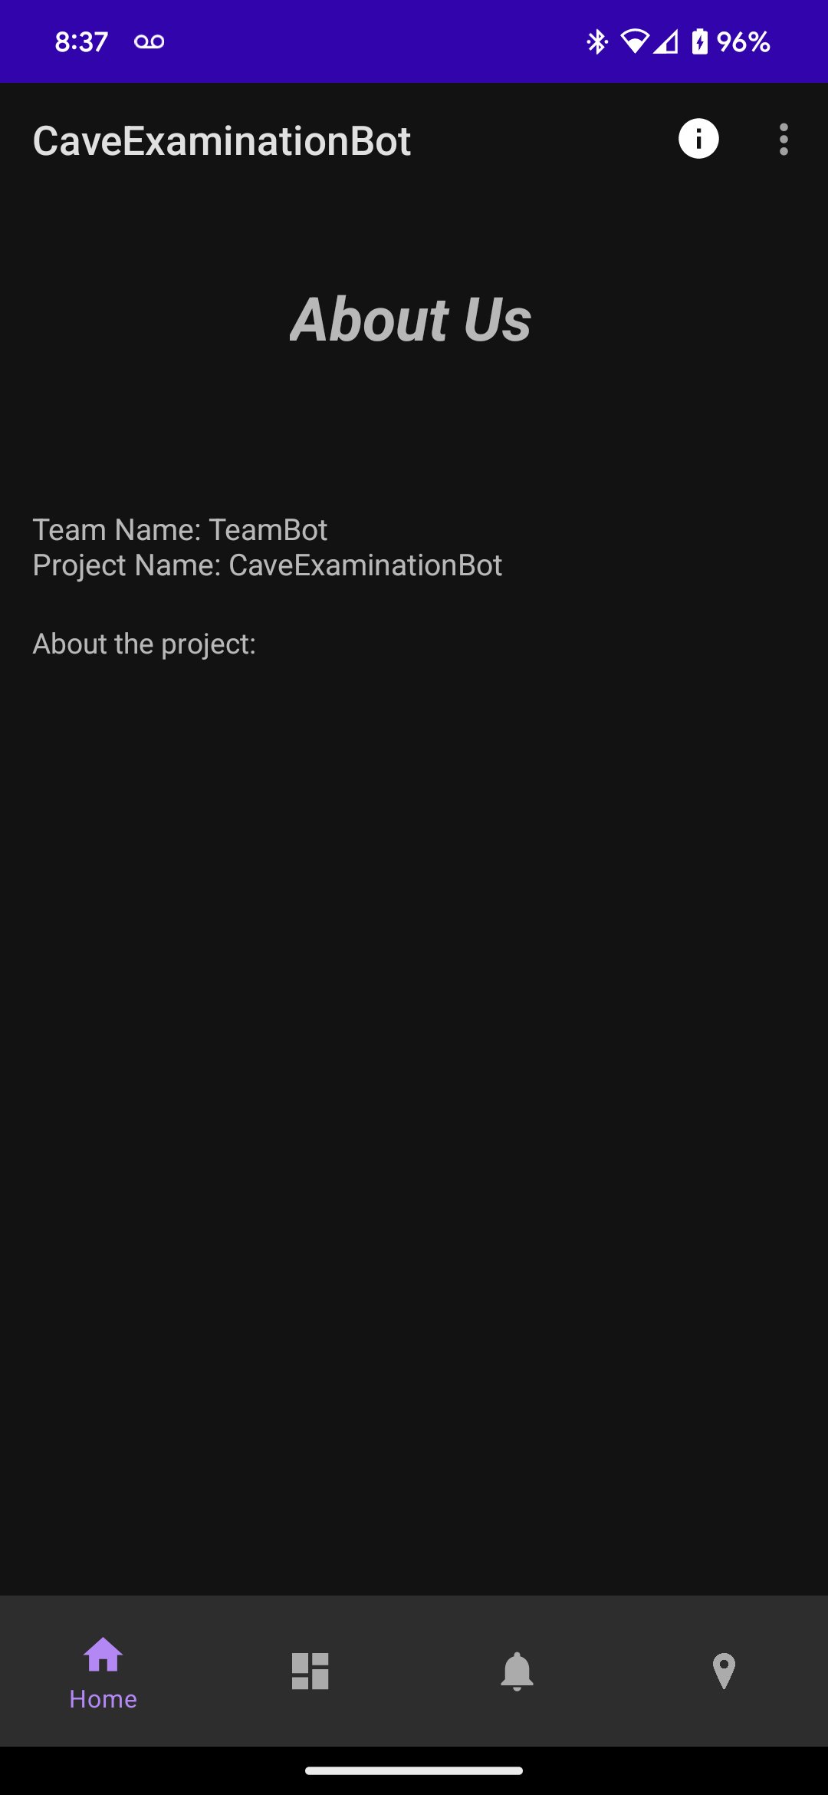
App screens – About us
About us
Of course, we must add a page describing us and our mission!

Slide 11
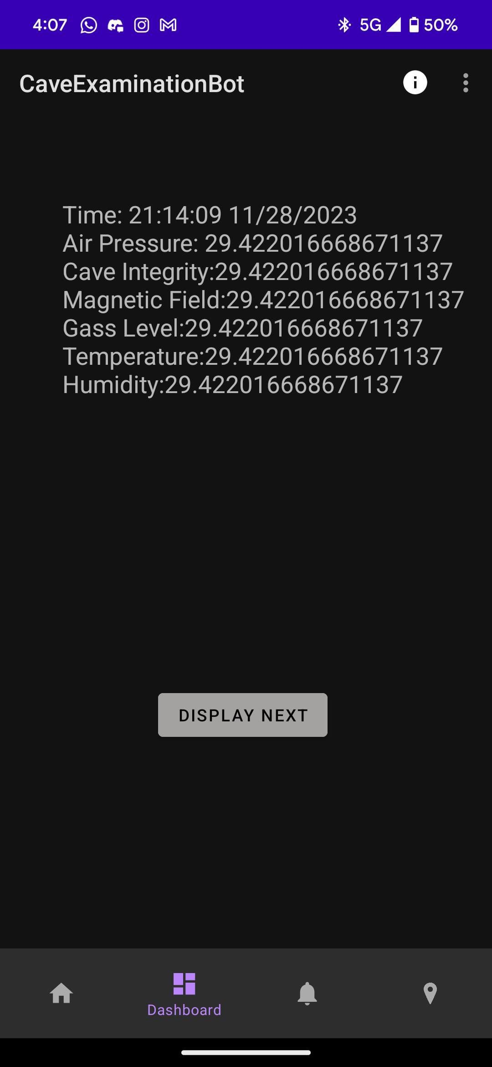
App screens – Local Data Review/Offline feature
Local Data Review and Offline feature
This local data screen will show the user their unique locally stored sensor data for further interpretation and analysis.
The offline feature is the data itself, if the user is logged in and gets disconnected from the database, they will still have their sensor data saved locally and will be able to see it.

Slide 12
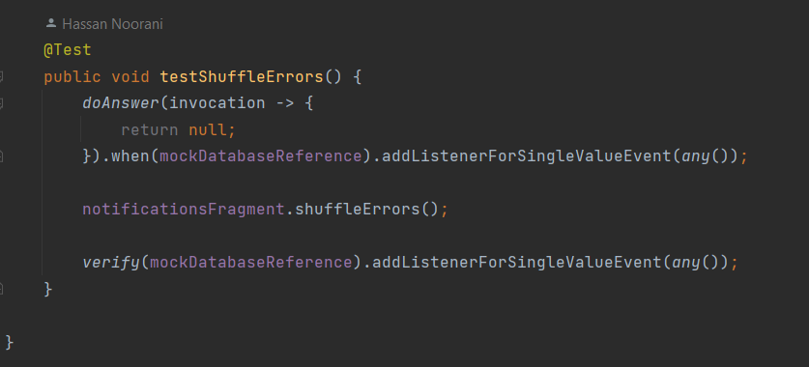
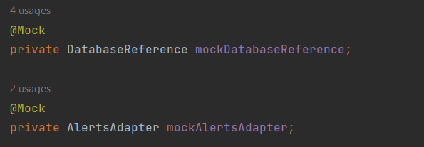
Test Cases:
testShuffleErrors:
Objective: Ensure shuffleErrors invokes addListenerForSingleValueEvent.
Mocked Dependencies: DatabaseReference.
Steps:
addListenerForSingleValueEvent returns null when invoked.
Call shuffleErrors and verify database interaction.

Slide 13
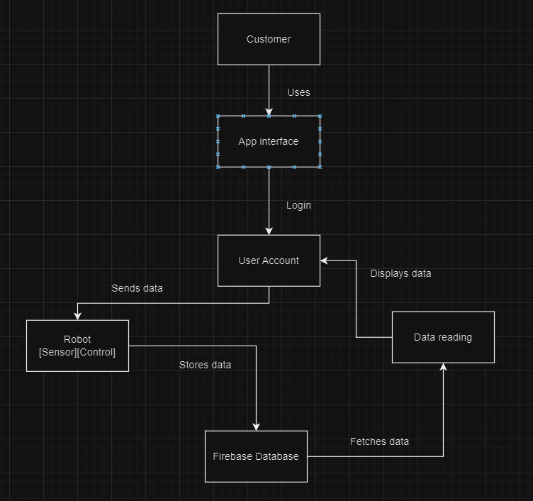
App flow
Our app follows a simple map in which we follow a step-by-step interface and results are shown in a regulated fashion.

Slide 14
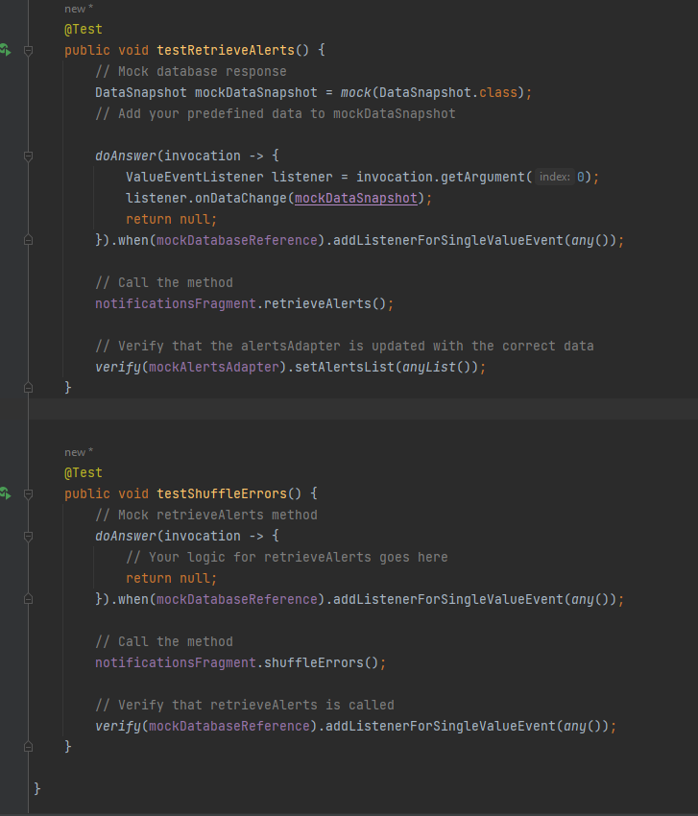
Test cases
We make sure to thoroughly test our code and keep our writing practices in line with industry standard

Slide 15
Git-hub strategy
Our approach to the contribution of the project on GitHub starts with setting a time in the day when each member will work on the project. Each member books a time in the week where they alone will work and clone the project. In this period all other members can answer any questions the member working on the software has about any previous code or contributions. Once a member implements their code, they will commit the code with an accurate description of the changes made. We work on the deliverable chronically and don't skip a step. Once all tasks for the day and week have been completed each member will clone the repository and perform tests and quality control, exploiting the app to find possible bugs and fixing them.

Slide 16
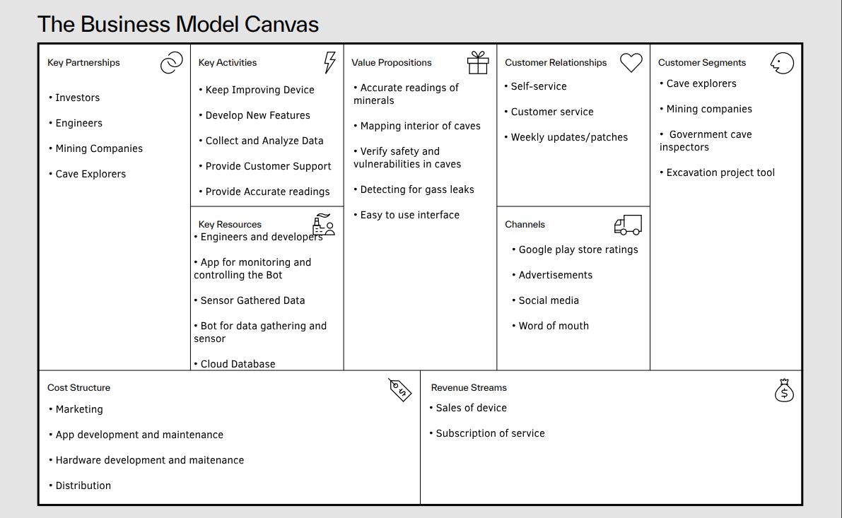
Business model Canvas

Slide 17
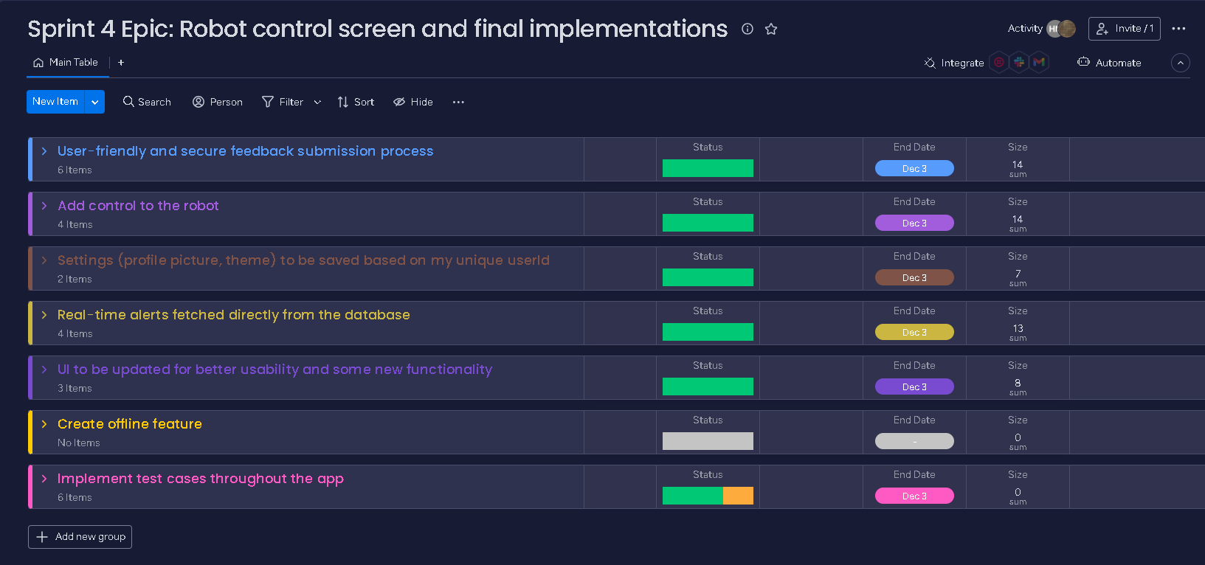
Sprint Dashboard
Overview of the epic for sprint 4 along with the stories and tasks.

Slide 18
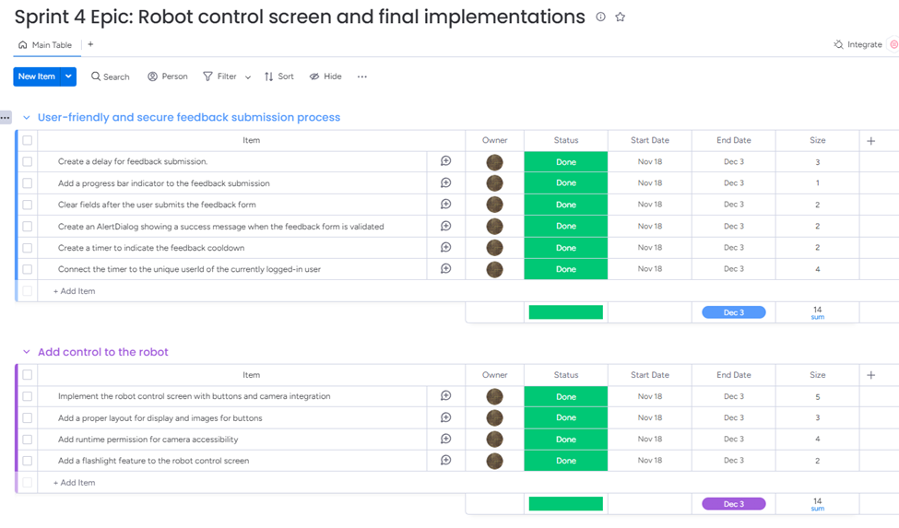
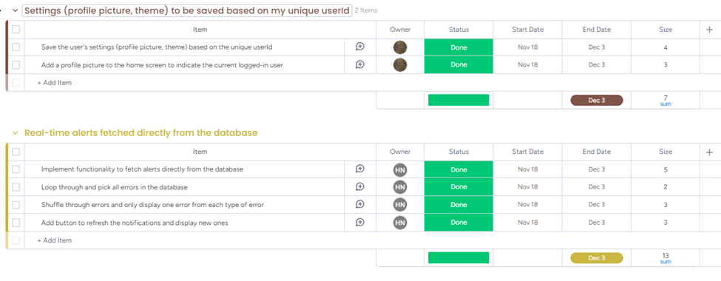
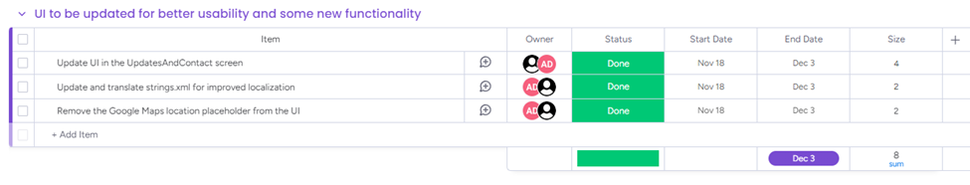
A detailed view

